Slide 1
Employee Data Analysis using Excel
STUDENT NAME: MERCY C
REGISTER NO : 312209211
DEPARTMENT : B.COM BANK MANAGEMENT
COLLEGE : ANNA ADARSH COLLEGE FOR WOMEN

Slide 2
PROJECT TITLE
Employee Performance Analysis using Excel

Slide 3
AGENDA
1.Project Overview
2.End Users
3.Our Solution and Proposition
4.Dataset Description
5.Modelling Approach
6.Results and Discussion
7.Conclusion

Slide 4

PROBLEM STATEMENT
Key Analysis Areas:
Employee Retention: Identify factors driving turnover.
Performance Analysis: Evaluate and compare employee performance.
Compensation Equity: Ensure fair and equitable salaries.
Diversity & Inclusion: Assess and improve workplace diversity.
Data Involved:
Employee demographics, job details, salary, performance scores, etc.
Expected Outcomes:
Reduced turnover, identified high performers, and ensured pay equity.
Enhanced diversity and inclusion strategies.
Tools:
Excel functions, Pivot Tables, Data Visualization.

Slide 5

PROJECT OVERVIEW
Scope:
Analyze employee data across key areas: retention, performance, salary, and diversity.
Utilize Excel for data cleaning, analysis, and visualization.
Methodology:
Data Preparation: Clean and standardize the dataset.
Analysis :Use descriptive statistics, pivot tables, and charts.
Evaluation : Identify trends, correlations, and insights.
Expected Outcomes:
Actionable insights to reduce turnover and improve employee satisfaction.
Identification of high performers and areas for support.
Recommendations for fair compensation and improved diversity.

Slide 6
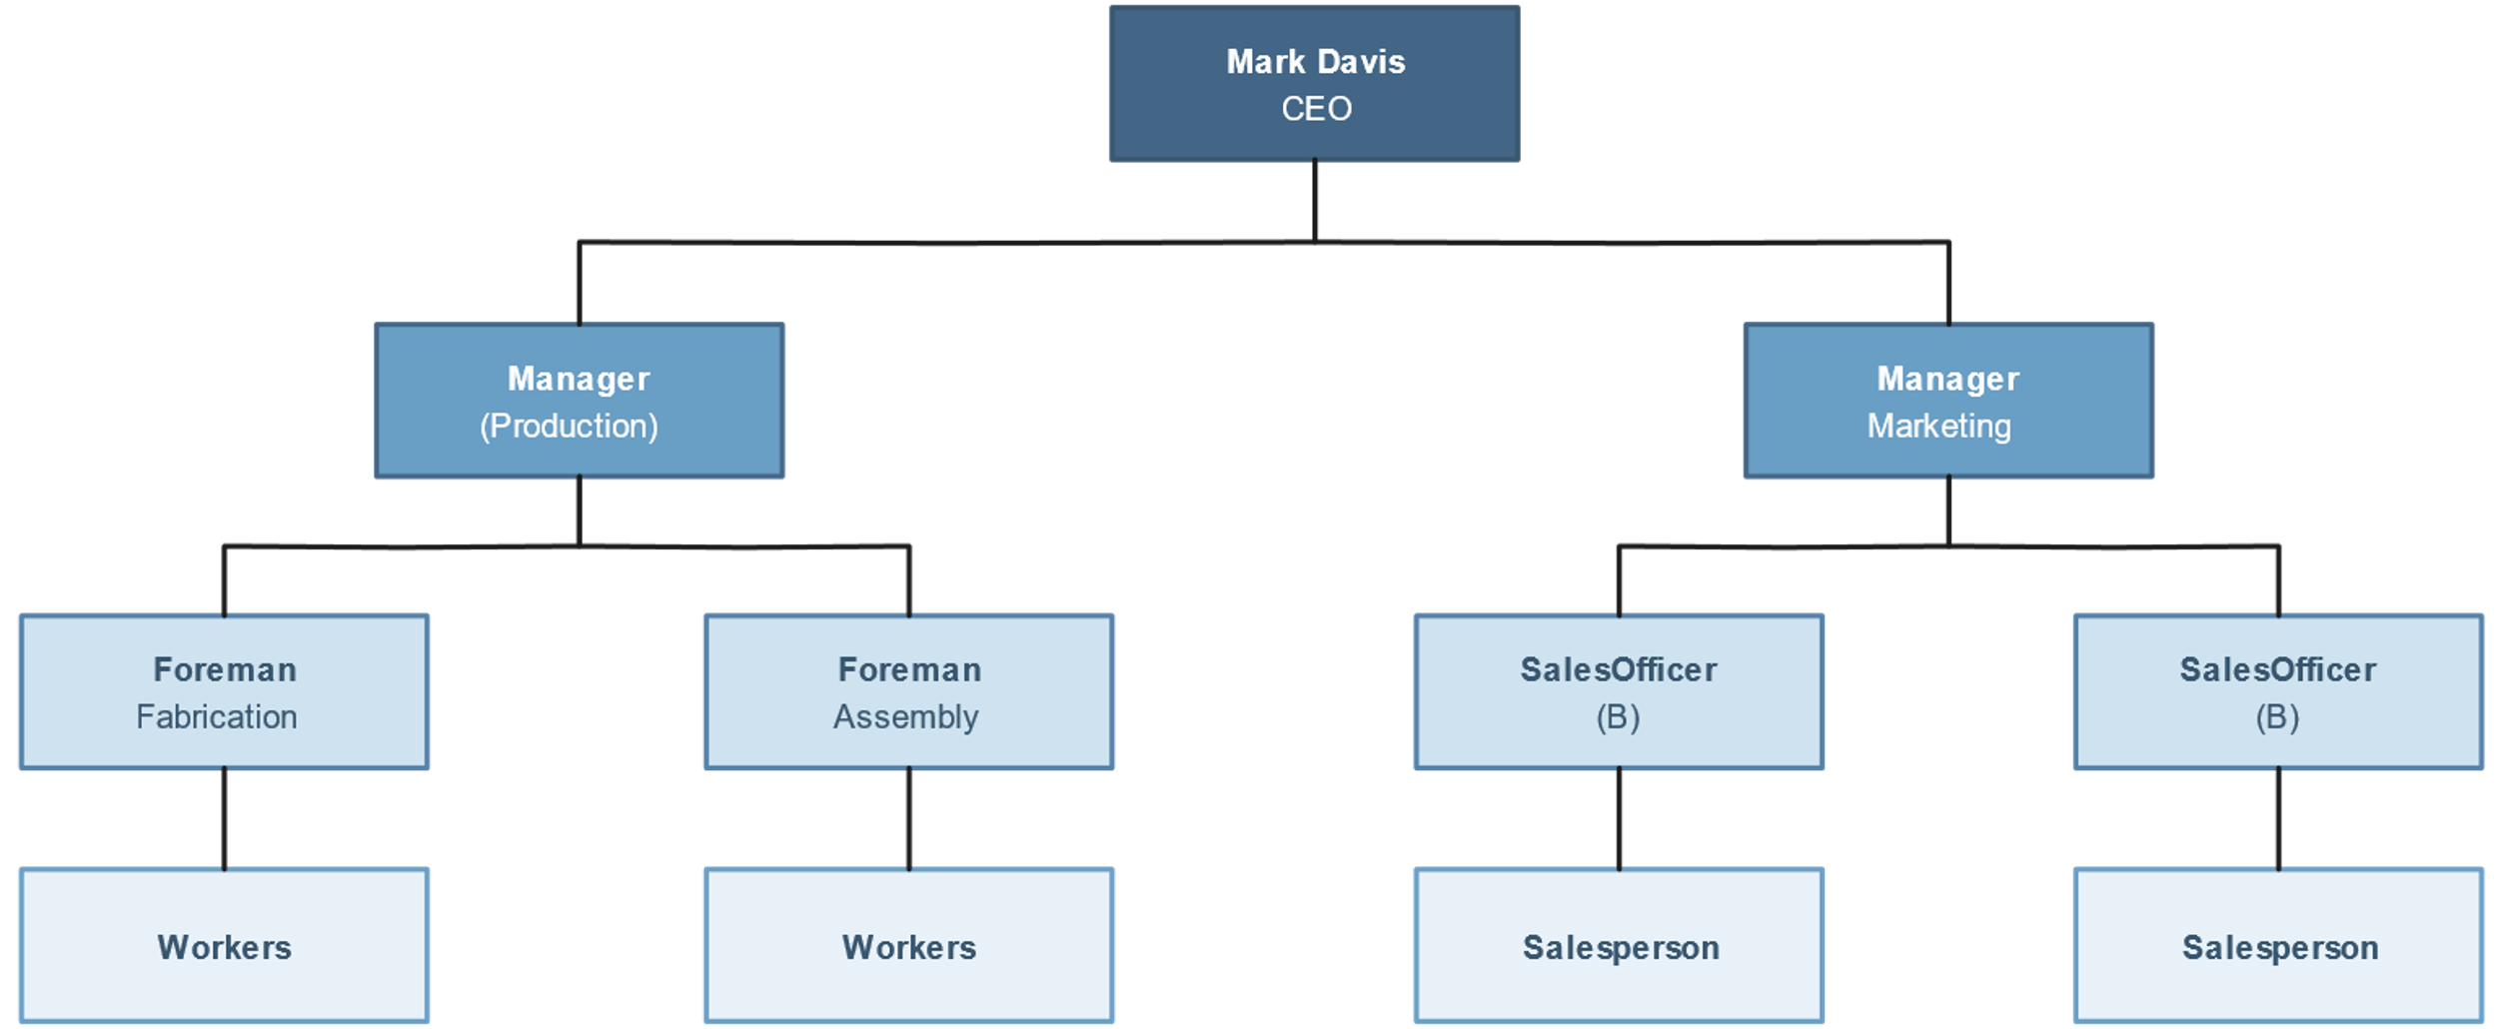
WHO ARE THE END USERS?

Slide 7
OUR SOLUTION AND ITS VALUE PROPOSITION
CONDITIONAL
FORMATTING –MISSING
FILLER- REMOVE
FORMULA- PERFORMANCE
PIVOT TABLE
GRAPH- DATA VISUALIZATION

Slide 8
Dataset Description
EMPLOYEE = KAGGLE
26- FEATURES
9-FEATURES
EMP ID-NUM
NAME-TEXT
EMP TYPE
PERFORMANCE LEVEL
GENDER-MALE FEMALE
EMPLOYEE RATING-NUM

Slide 9
THE "WOW" IN OUR SOLUTION
PERFORMANCE LEVEL =IFS(Z2>=5,"very high",Z2>=4,"high",Z2>=3,"med",
TRUE,"low")

Slide 10
MODELLING
DATA COLLECTION
GAGGLE TO DOWNLOAD THE DATA
FEATURE COLLECTION
EMPLOYEE STATUS
EMPLOYEE TYPE
GENDER CODE
PERFORMANCE SCORE
CURRENT EMPLOYEE RATING
DATA CLEANING
MISSING VALUE IDENTIFY
MISSING VALUE FILTER
PERFORMANCE LEVEL SUMMARY
CREATE A PIVOT TABLE
CREATING GRAPH

Slide 11
RESULTS
GenderCode | (All)
Count of FirstName | performance level
BusinessUnit | high | low | med | very high | Grand Total
BPC | 16 | 34 | 85 | 15 | 150
CCDR | 18 | 47 | 65 | 15 | 145
EW | 21 | 41 | 78 | 14 | 154
MSC | 17 | 39 | 92 | 9 | 157
NEL | 21 | 41 | 77 | 15 | 154
PL | 29 | 33 | 69 | 12 | 143
PYZ | 26 | 41 | 75 | 15 | 157
SVG | 26 | 43 | 82 | 16 | 167
TNS | 21 | 45 | 71 | 13 | 150
WBL | 25 | 34 | 84 | 13 | 156
Grand Total | 220 | 398 | 778 | 137 | 1533

Slide 14
CONCLUSION
Key Findings:
Sales targets exceeded by 80% of employees.
Customer service ratings below target in 30% of cases.
Interpretation:
Effective sales strategies in place.
Need for improvement in customer service processes.
Recommendations:
Implement training to enhance customer interactions.
Share top sales strategies across teams.
Final Thought:
"By acting on these insights, we can improve overall performance and achieve our strategic goals."

